Slide 2
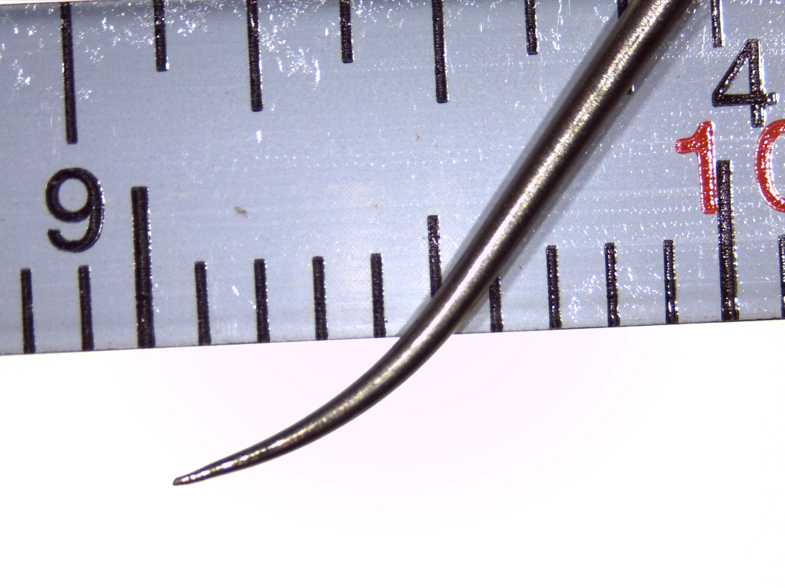
R = 10cm
14mm = 1mm

